Slide 1



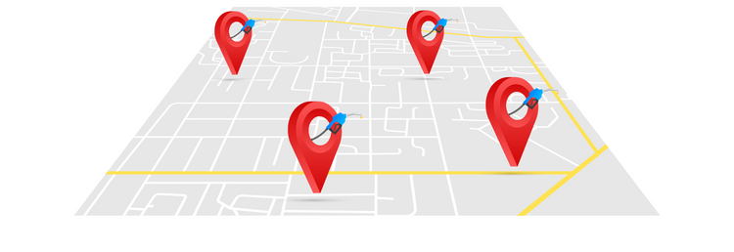



DATA472-24S1
DATA ENGINEERING
FUEL RECOMMENDER APP FOR CHRISTCHURCH
Presented by:
Hua Wang
Hussain Ravat
Swathy Padinjareveliyil Thankachan
Panli Wang

Slide 2
1
GOAL
Develop a mobile app to enable users to find the best gas station in Christchurch based on relative score based on distance, fuel prices, and potential savings.

Slide 3




2
WORK FLOW
Data collection from each Gas brand official website.
Clean the data and store it in the database.
Store the data in the PostgreSQL database.
Provide the API for the mobileend with PostgresAPI.

Slide 4


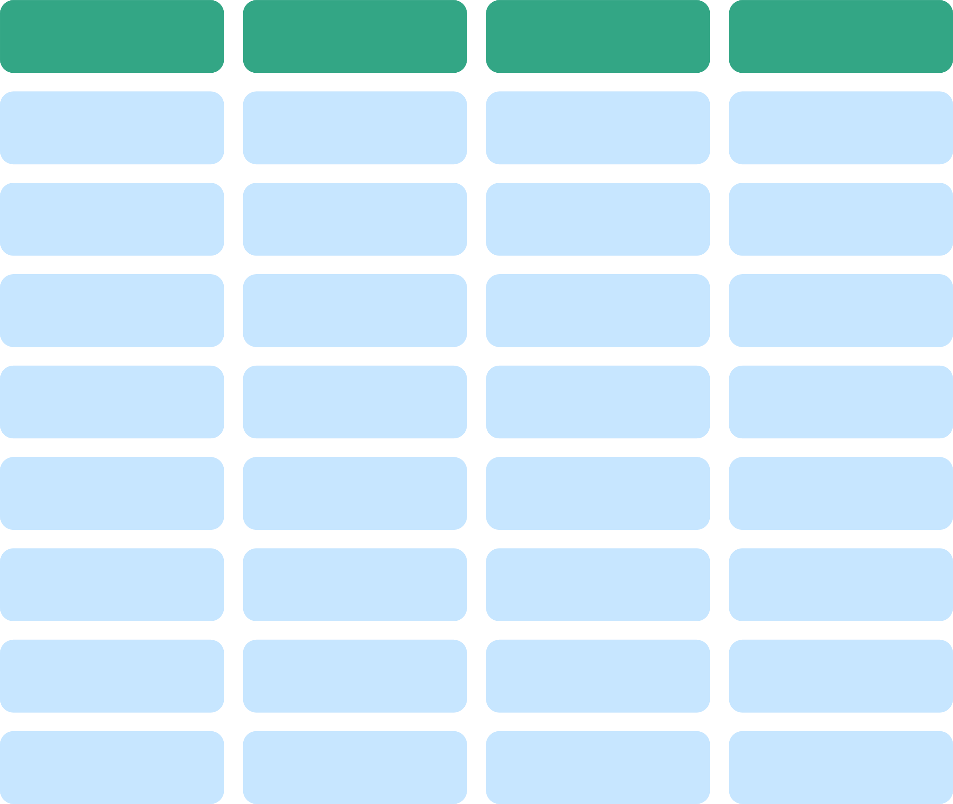


3
DATA PIPELINE
Data collection service
BP
Z
.
.
.
.
.
.
Mobil
Scrap and wrangle
APP
PostgresSQL Database

Slide 5
4
DATABASE ENTITY DIAGRAM
gas_station | gas_station
PK | gas_station_id
 | name
 | latitude
 | longitude
 | address
 | brand_id
gas_price | gas_price
PK | gas_price_id
FK | gas_station_id
 | price
 | fuel_type_id
 | date
brand | brand
PK | brand_id
 | brand_name
fuel_type | fuel_type
PK | fuel_type_id
 | fuel_type_name

Slide 6
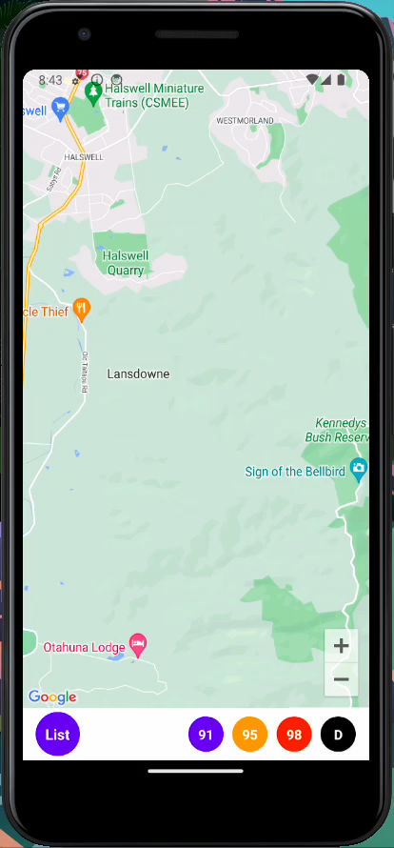
5
RESULTS

Slide 7



5
CHALLENGES
Limited availability if fuel price information
Learning curve
Limited time constraints

Slide 8
THANKS

